Slide 1
Updates and Reminders
For additional background, check out the short videos of cell division & CDK regulation, and a brief audio overview of tumor suppressor genes on Canvas (in module for Lecture 8)!
Quiz #2 on Monday 2/10
Study session with PLA Sunday
Study session with TA Monday 10-12 SL lounge

Slide 2
Lecture 9 Objectives
Begin to appreciate what remains unclear about pRB’s function as a tumor suppressor
Be able to describe ways in which p53 does not function as your ‘typical’ tumor suppressor
Be able to explain how point mutations and deletions in TP53 have different impacts on cell biology, and why point mutations are more prevelant
Be able to identify and describe ways in which pRB function and p53 function are regulated differently

Slide 3
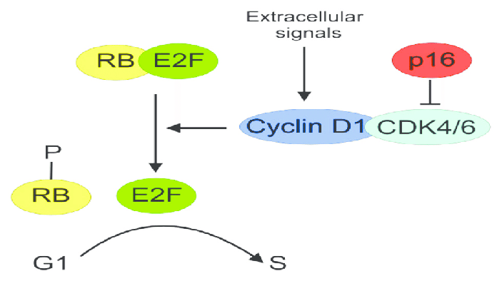
Summary: Cell cycle regulation
Cell cycle progression is controlled by changing levels and availability of cyclins
Expression gradually ramps up
Regulated, abrupt degradation at transitions between stages
Cyclin expression is initially controlled by extracellular signals (i.e. mitogens) in G1
Cyclins bind to Cyclin dependent kinases (CDKs) and promote their activity
Cyclin/CDK complex activity can be mitigated by inhibitor proteins (CDK inhibitors) that disrupt cyclin/CKD complexes or inhibit CDK kinase activity
kinase

Slide 4
Restriction Point Control
pRB is the dominant regulator of the restriction point
pRB limits expression of genes needed for S phase by binding and inhibiting E2F transcription factor
pRB is regulated by Cyclin/CDK-dependent phosphorylation
inactive
active

Slide 5
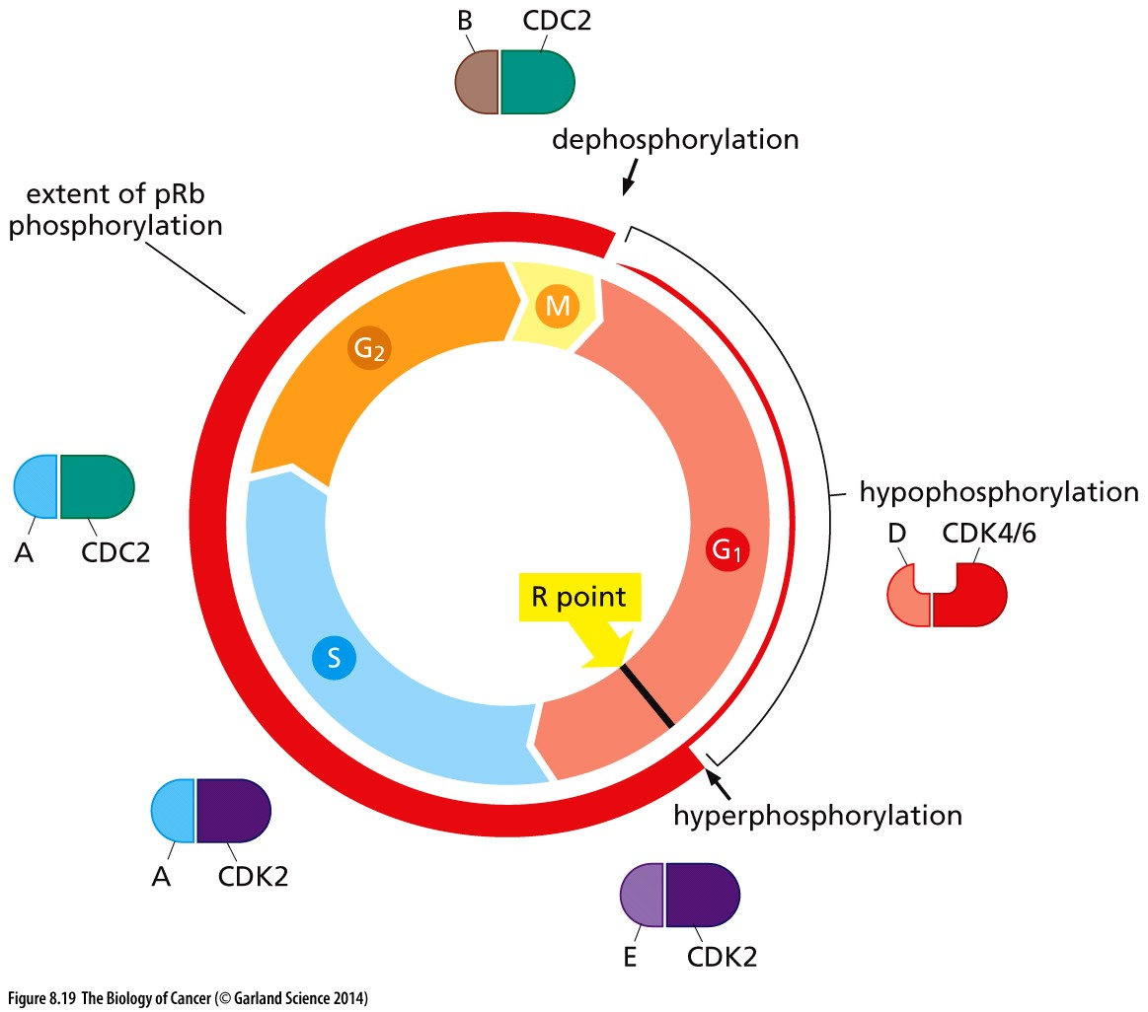
Control of pRB
pRB is the dominant regulator of the restriction point
pRB limits expression of genes needed for S phase by binding and inhibiting E2F transcription factor
pRB is regulated by Cyclin/CDK-dependent phosphorylation

Slide 6
Why pRB?
pRb is one of 3 ‘pocket proteins’ that are functionally redundant
pRB
P107
P130
Cancers where Cyclin D is overexpressed or CDK4 is amplified → inhibition of pRB, p107 AND p130
But ONLY pRB (and never p107 or p130) is mutated or lost in cancer
WHY?
Each can bind and inhibit E2F-dependent transcription
Each is regulated by Cyclin/CDK-dependent phosphorylation
suggests that pRB does something DISTINCT; loss of p107 or p130 is not sufficient to promote cancer

Slide 7
pRB regulates differentiation
Cells that differentiate are post mitotic
specialized functions (muscle cells, neurons, etc)
will never replicate or divide again
Ability to differentiate is linked to pRB function
Hyperphospho-pRB → cell proliferation
Hypophospho-pRB → quiescence or differentiation
Same molecular regulators are important for the decision to proliferate and to differentiate
Cyclin/CDKs
CDK inhibitors

Slide 8
2 ‘hits’ in one
Genetic lesions that corrupt pRB regulation BOTH
Promote proliferation
Prevent differentiation
Not clear if p107 and p130 function redundantly in regulation of differentiation??

Slide 9
What else does pRB do?
Also regulates key features of later cell stages
Chromatin compaction in prep for mitosis
Centromere function and chromosome segregation
Is this where pRb function is distinct from p107 & p130?
Still not known…
E2F is only one of many transcription factors pRB binds
How does disruption of other interactions impact cancer?
Mitotic regulation?
Differentiation?

Slide 10
P53: Master Guardian of the Genome
pRB: controls cell cycle response to the outside world
p53 (aka TP53): monitors internal well-being of the cell
Monitors and responds to genetic damage
damage is moderate → cell cycle arrest and damage repair
damage is extensive → cellular suicide (apoptosis)

Slide 11
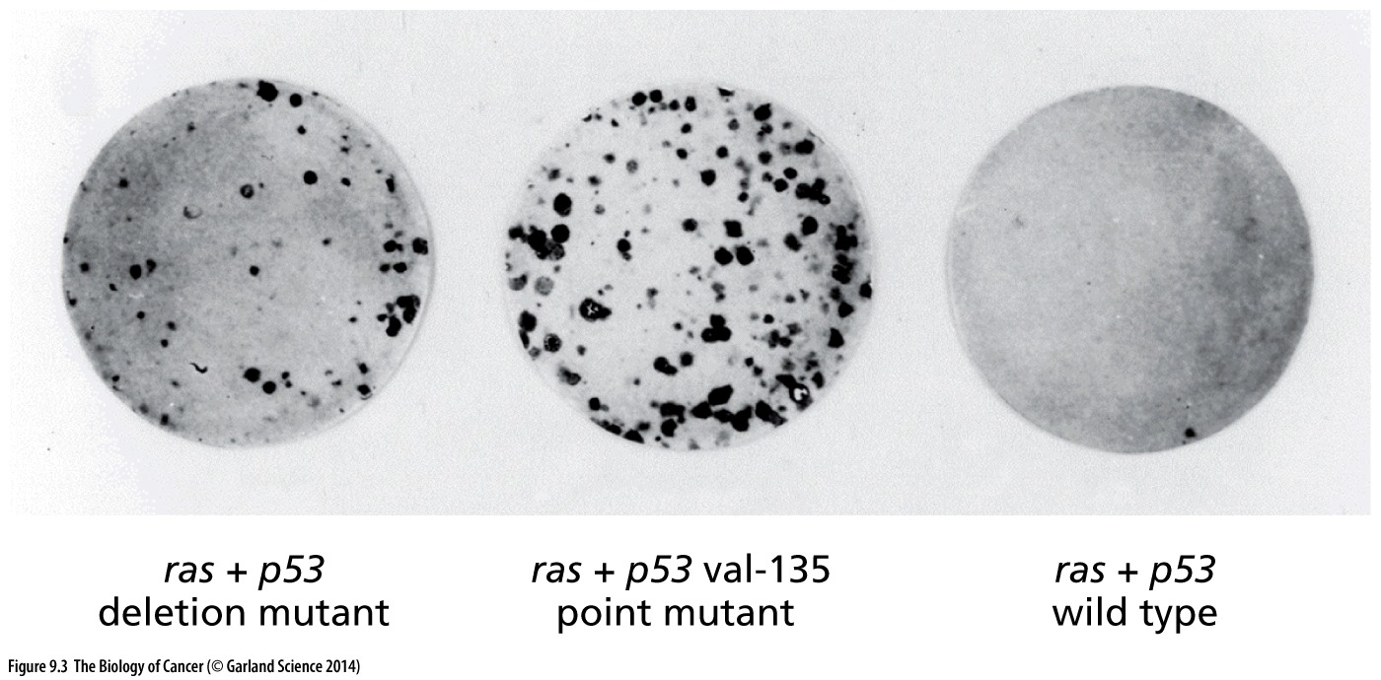
Tumor suppressor or oncogene?
Initial studies show expression of a mutant p53 promotes cell growth → functions like an oncogene
ras oncogene promotes cell growth (colonies of cells stained black)
Expression of ras oncogene + a single copy of the p53 mutant from a cancer cell promotes MORE cell growth
How else are oncogenes commonly misregulated?

Slide 12
Tumor suppressor or oncogene?
Initial studies show expression of a mutant p53 promotes cell growth → functions like an oncogene
BUT expression of extra wild-type p53 prevented ras-driven cell growth → normal function is like a tumor suppressor

Slide 13
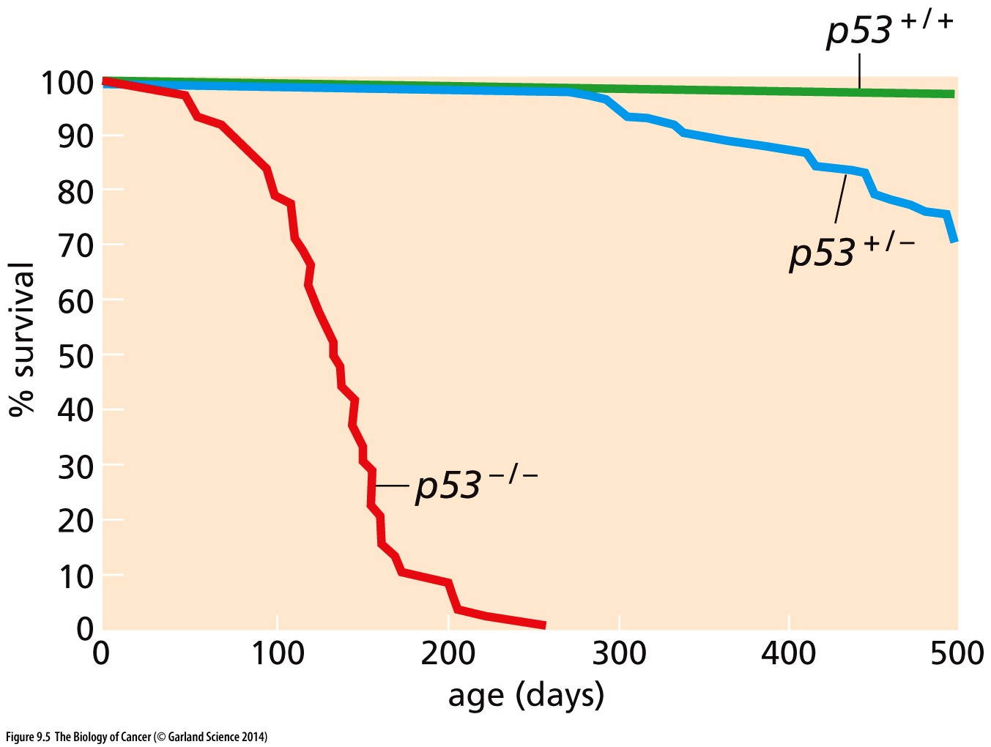
Unlike other tumor suppressors
Loss of both copies of a tumor suppressors like pRB in the germline of a model organism → nonviable
Embryonic development is disrupted by overproliferation
Tissues are dysregulated
p53 null animals are viable
Mice survive past birth
succumb to tumors

Slide 14
The gatekeeper
p53 doesn’t restrain the cell cycle per se
If unchallenged/undamaged, cells without p53 may not enter the cell cycle any more frequently than those with p53
Prevents the survival of abnormal cells
In the absence of p53, cells with damage may remain in the cell cycle when they otherwise wouldn’t

Slide 15
p53 in cancer
Mutated in at least ½ of all human cancers
p53 mutations are always missense mutations, never nonsense mutations that would lead to loss of p53 protein
p53 mutation is dominant, not recessive as most tumor suppressors → mutation of a single allele is tumorigenenic
How is this possible? Why isn’t the remaining ‘good’ allele function enough?

Slide 16
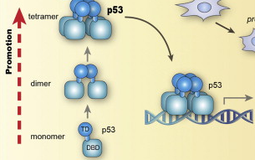
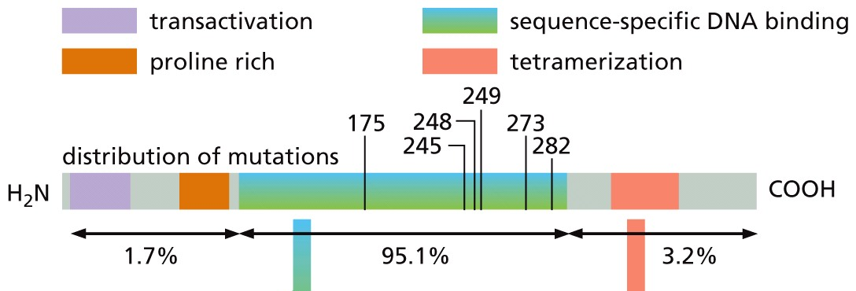
Understanding p53 mutations
Biochemical studies show p53 functions as a homotetramer
Most p53 mutations occur in the DNA binding domain of the protein
Transcription factor that binds to DNA
DNA binding domains of all 4 subunits must be intact for p53 function
Mutations rarely disrupt the tetramerization domain

Slide 17
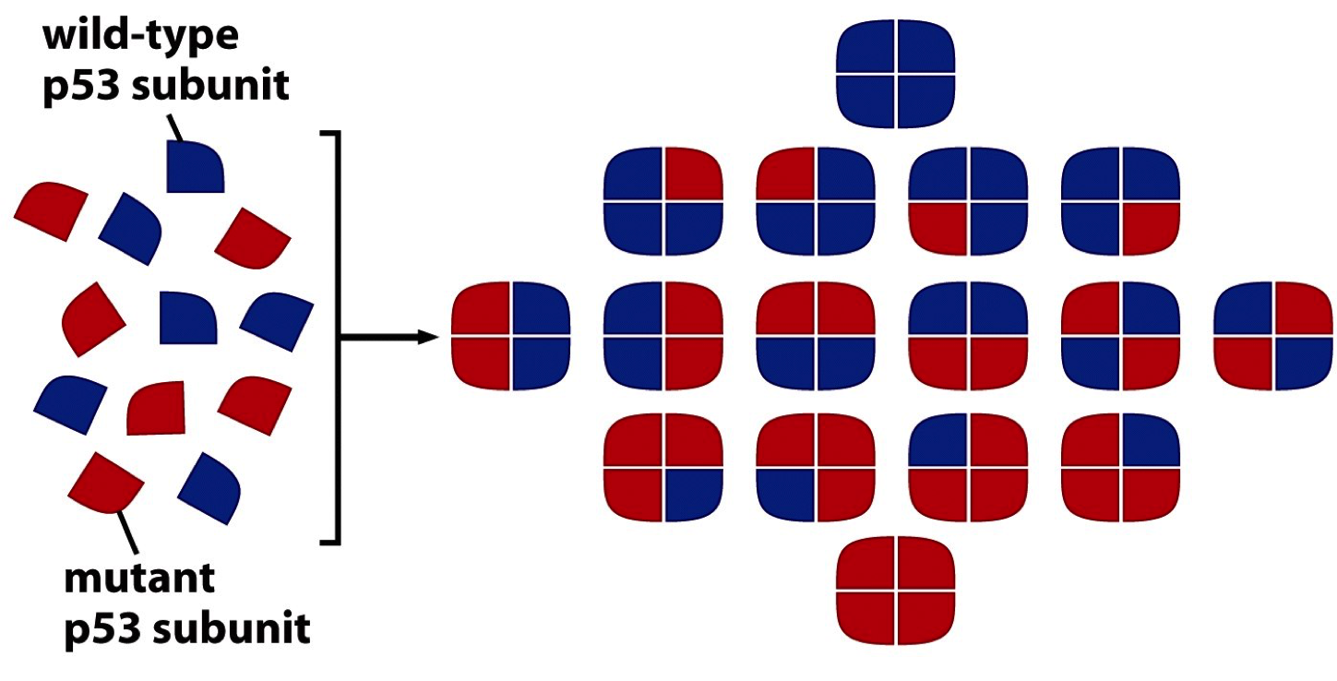
The weakest link
Incorporation of 1 mutant p53 protein into a tetramer will interfere with the protein complex’s function
How might a TP53 gene deletion be better or worse than a mutation?
Ratio of mutant: wildtype alleles is 1:1
Ratio of non-functional: functional tetramers is 15:1
If 1/16 is still too much → LOH to lose the remaining ‘good’ copy

Slide 18
Regulation of transcription factors
Required co-factors for the transcription factor are regulated
Activity of the transcription factor is modulated
What we see with pRB/E2F regulation
Concentration of the transcription factor
Expression level
Recruitment to/from the nucleus
→ p53 levels vary dramatically between cells types and in response to stress
How is p53 protein levels regulated?

Slide 19
Examining protein turnover
Protein levels are the result of how much protein is made and how fast that protein is turned over/degraded
Protein expression depends on the function of the ribosome
Protein degradation depends on the function of the proteosome
In the absence of new protein being made, change (or no change) in protein levels is due to proteasome-dependent degradation

Slide 20
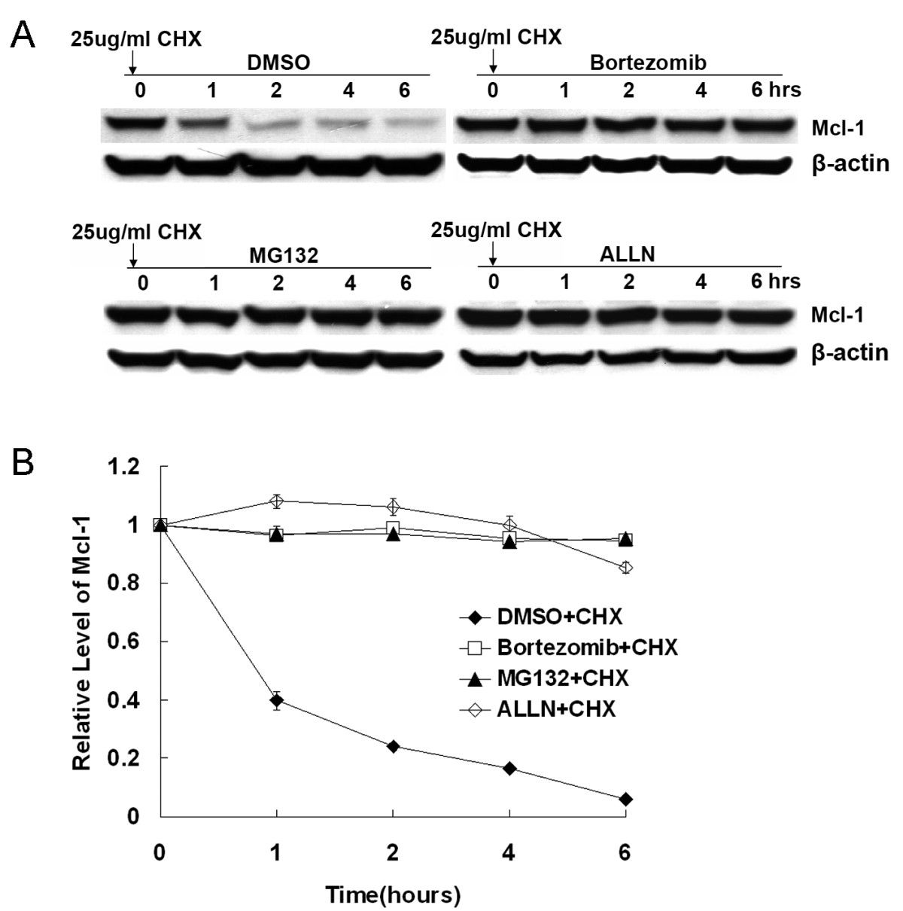
Measuring protein turnover
Experiment #1:
Cells are treated with Cyclohexamide (CHX) for the indicated times
Western blots are performed to assess levels of specific proteins
Time (hours)
Protein 1
Protein 2
What can you say about the turnover of protein 1? Protein 2?
What would you expect to happen to protein 1 if you also inhibited protein degradation? What would happen to protein 2?
Experiment #2:
Cells are treated with CHX & the proteasome inhibitor MG132 for the indicated times.
Western blots are performed to assess levels of specific proteins
Time (hours)
Protein 1
Protein 2

Slide 21
Primed and ready to respond
p53 has a ½ life of only ~20 minutes
Energetically wasteful to make a protein only to rapidly degrade it BUT provides remarkable ability to respond to physiological signals
P53 is always highly expressed & rapidly degraded
p53 levels can be doubled every 20 minutes simply by blocking protein degradation
What signals stabilize p53?

Slide 22
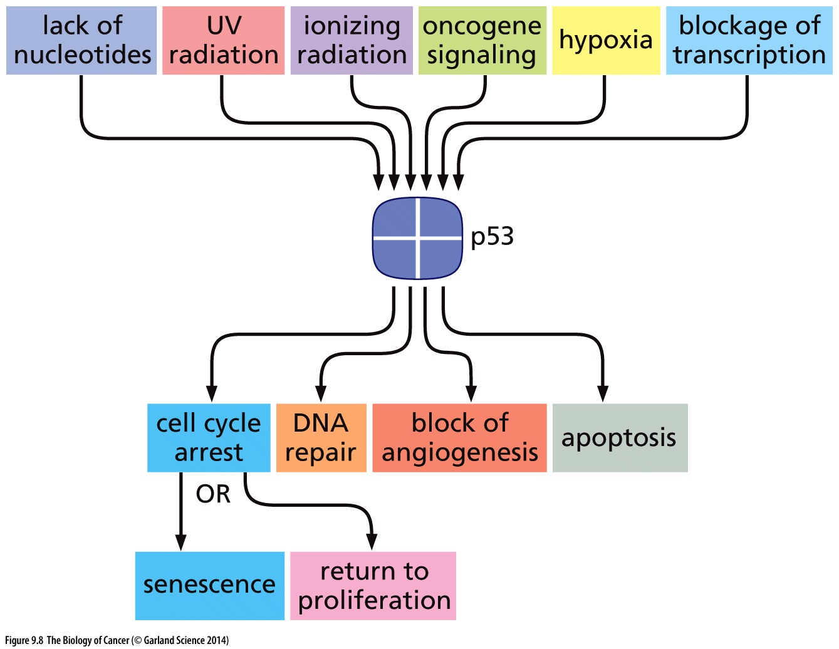
p53 is responsive to genotoxic stress
DNA damage sensors activate kinases that phosphorylate p53
Phosphorylated p53 is stabilized and active
P
P
P
P

Slide 23
Halting the cell cycle
Genotoxic stress → stabilization of p53 → increased CDK inhibitor (p21)
What effect do you expect increased p21 to have?

Slide 24
Halting the cell cycle
Genotoxic stress → stabilization of p53 → increased CDK inhibitor (p21)
CDKi inhibits Cyclin/CDK complexes and halts cell cycle progression → through phosphorylation of pRB
Cell cycle arrest allows time to repair damage → survival
Loss of p53 function = failure to arrest in response to damage, less repair & potential for more mutations
How are low p53 levels restored after damage is repaired?

Slide 25
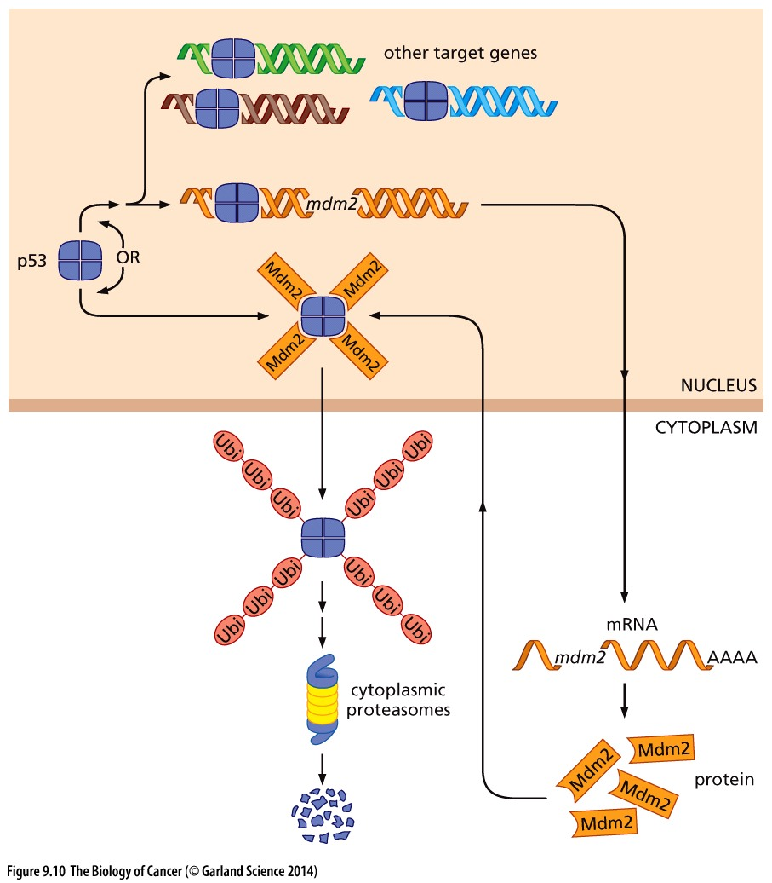
Restoring low p53 levels
p53 is a transcriptional regulator → promotes expression of MDM2
MDM2 is as ubiquitin ligase → places ubiquitin ‘tags’ on p53 to mark it for degradation
Cancers can hijack this process & overexpress MDM2
Onocgenic MDM2 keeps p53 levels low and prevents cell cycle arrest

Slide 26
Draw a concept map
How is p53 regulated in response to damage?
How is the restriction point regulated in parallel?
How/where do these pathways intersect/have crosstalk?

